Slide 1

Searchable encryption
Ostepoc Lucian
Nicu Andrei
Grigorita Mihai-Adrian
Tanase Bianca
http://www.amichalas.com/blog/

Slide 2
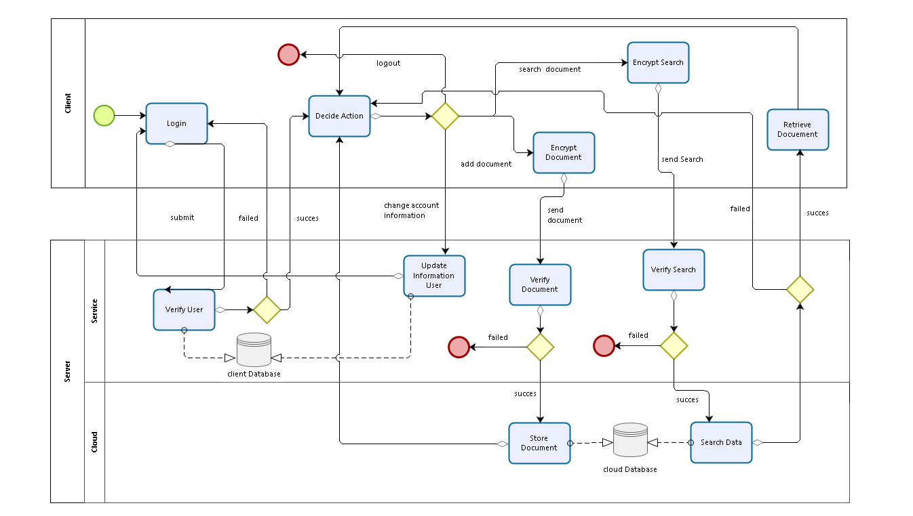
BPMN

Slide 3
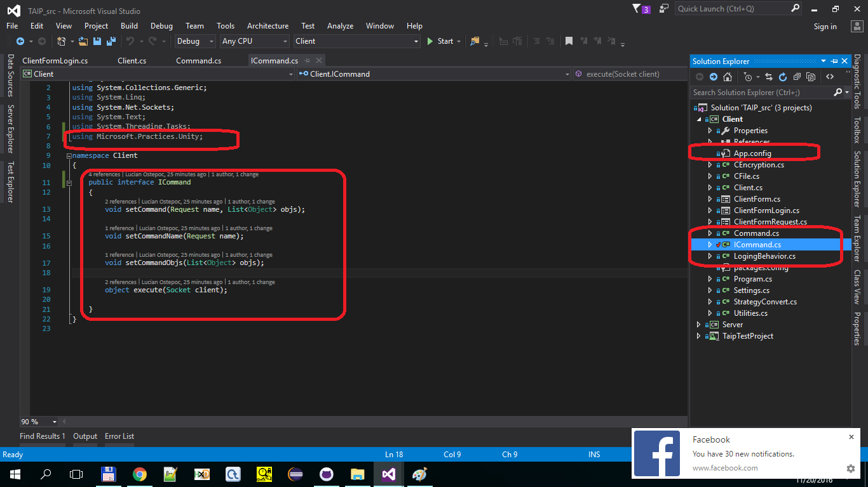

Slide 4
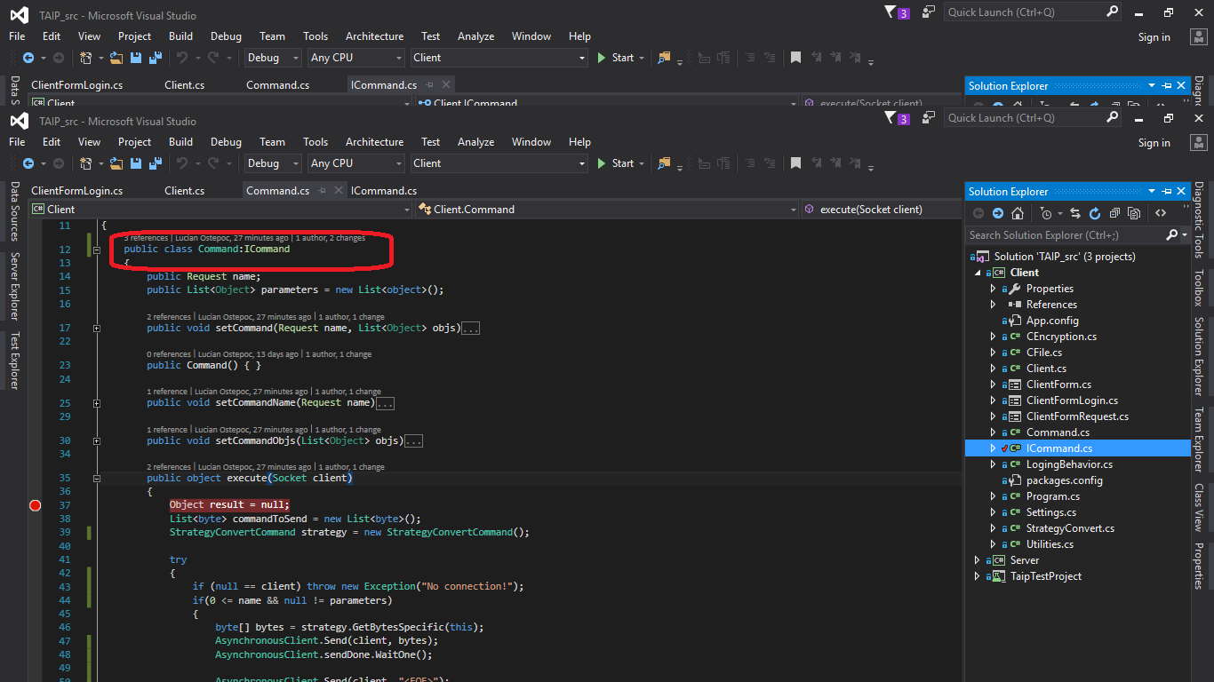

Slide 5
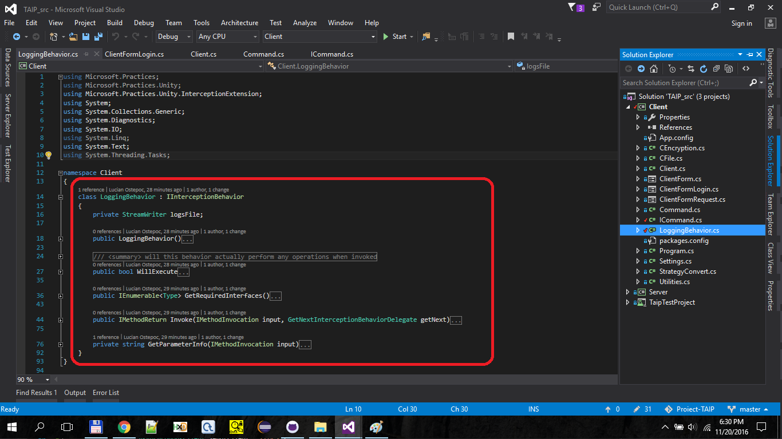

Slide 6
